Slide 1
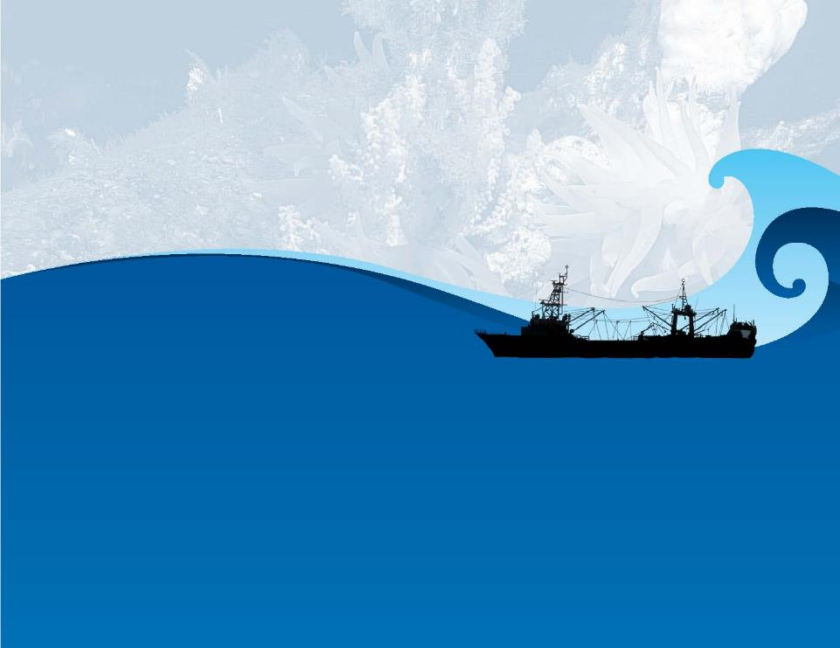



ABNJ Deep Sea Fisheries Project
William Emerson
Tony Thompson
Lena Westlund
10th Meeting of the SPRFMO Commission
24-28 January 2022

Slide 2
Common Oceans Program
Common Oceans Program Sustainable utilization and conservation of biodiversity in areas beyond national jurisdiction
Program
Global Coordination Project for the Common Oceans ABNJ Program
Sustainable management of tuna fisheries and biodiversity conservation in ABNJ
Deep-sea Fisheries under the Ecosystem Approach
Strengthening the stewardship of an economically and biologically significant high seas area – the Sargasso Sea
Building and Enhancing Sectoral and Cross-Sectoral Capacity to Support Sustainable Resource Use and Biodiversity Conservation in ABNJ
5 Projects

Slide 3
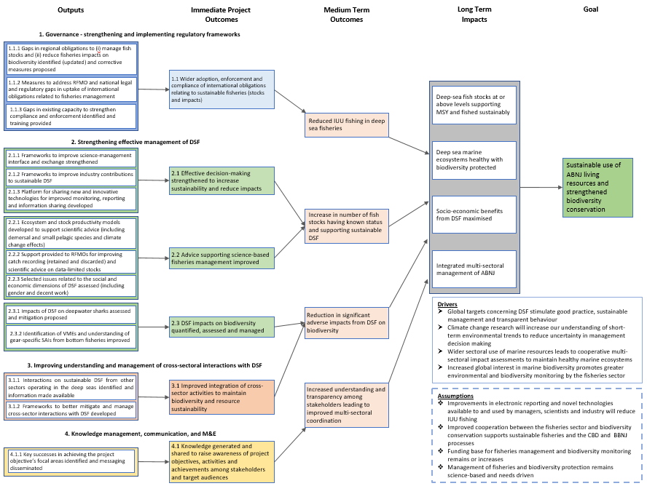
The DSF Project
Partners
RFMOs: GFCM, NAFO, NEAFC, NPFC, SEAFO, SIOFA, SPRFMO
Science advisory body: ICES
Governments: NOAA
Private sector: SIODFA, ICFA, Sealord
Component 1 – Governance, legal, enforcement, compliance
Component 2 – Science and science-management interface Component 3 – Cross-sectoral activities affecting DSF Component 4 – Knowledge management, communication

Slide 4
Key DSF Project activities
Targeted in-kind and project funded studies supporting science, compliance and management
Global reviews
Opportunity for RFMOs to discuss issues of common interest
Non-RFMO stakeholders informed of the RFMO work on sustainable development (reaching beyond project partners)

Slide 5
NEXT Steps
Seeking SPRFMO support to become a DSF Project partner
Seeking SPRFMO co-financing letter
Final Project Document submitted to GEF on 25 November 2021 for endorsement
DSF Project launch mid-2022

Slide 6
THANK
YOU

